Slide 1
Jumbo & Company Store Performance and Attach Rate Dashboard

Slide 2
Overview
This dashboard provides a comprehensive analysis of store performance across regions and categories, focusing on attach rates over recent months, forecasted performance, and key trends. It enables identification of top and underperforming branches, seasonal patterns, and category-level insights to drive targeted improvements and strategic planning.

Slide 3
Overall Insights
  The Needs Improvement category dominates store distribution, representing the largest share with 102 stores, while Good has 58 and Excellent only 3 stores, indicating most locations underperform or need improvement.
  In performance terms, Excellent stores have the highest average attach rate at 54.1%, slightly above their forecast of 52.7%, suggesting strong actual performance relative to expectations.
  Both Good (27.2%) and Needs Improvement (11.8%) attach rates underperform vs their forecasts (Good: 31.6%; Needs Improvement: 13.7%), with Needs Improvement the lowest among the three categories.
  Pune is the standout branch, delivering the strongest and most consistent attach-rate performance, peaking at 36% in November and ending December at 29%.
  Delhi NCR shows steady improvement from 19% in August to 28% in November/December, while Telangana and Gujarat exhibit notable late-year spikes (Telangana to 19% in November; Gujarat to 19% in December).
  Mumbai and Thane display more modest, stable attach rates, with Mumbai peaking at 22% in October and Thane reaching the mid-teens by December.

Slide 4
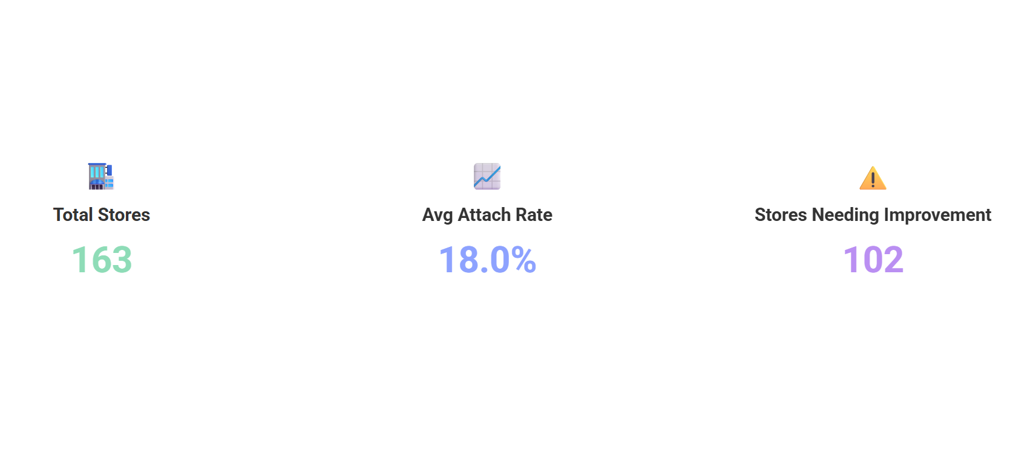

Slide 5
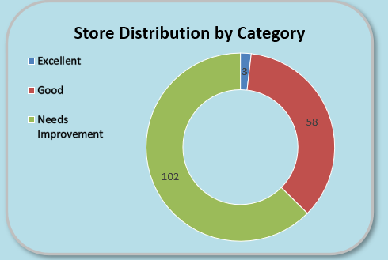
Key Insights
  Needs Improvement category represents the largest share (102 stores), comprising the majority of stores
  Good category is the second largest (58 stores) while Excellent is very small (3 stores), indicating limited top-performing locations

Slide 6
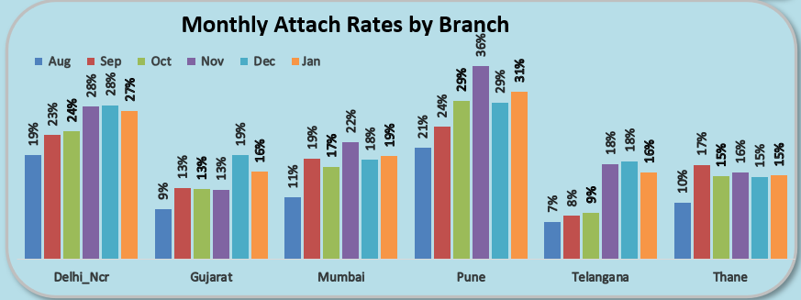
Key Insights
  Pune shows the strongest and most consistent performance, peaking at 36% in Nov and finishing Dec at 29%
  Delhi_Ncr also improves steadily from 19% in Aug to 28% in Nov/Dec, while Telangana and Gujarat show notable late spikes (Telangana to 19% in Nov, Gujarat to 19% in Dec)
  Mumbai and Thane have modest, relatively stable attach rates with Mumbai peaking at 22% in Oct and Thane improving to mid-teens by Dec

Slide 7
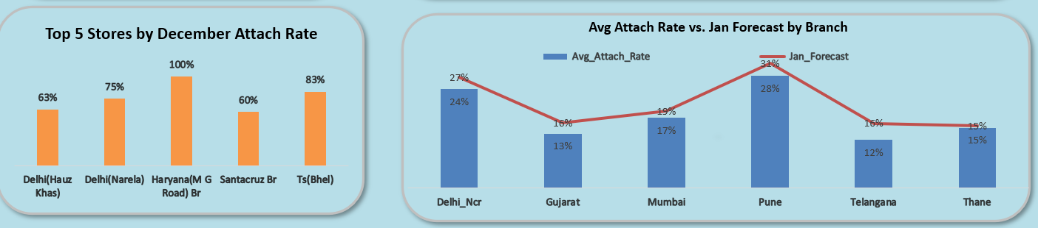
TOP 5 Stores by December Attach Rate & Avg Attach Rate vs Jan Forcast

Slide 8
Key Takeaways & Action Plan
• High performers achieve 40–60% attach rates consistently
• Jan Forecast shows strong upside in select NCR, Pune & Mumbai stores
• Immediate focus required on zero/low attach locations
Recommended Actions:
• Replicate top-store sales scripts
• Weekly attach tracking & accountability
• Target-based incentives for Jan–Feb

